Slide 1
Lecture 1: Introduction to deep learning
Practical deep learning

Slide 2
About this course
Introduction to deep learning
basics of ML assumed
mostly high-school math
much of theory, many details skipped
1st day: lectures + small-scale exercises using notebooks.csc.fi
2nd day: experiments using GPUs at Puhti-AI
Slides at: https://tinyurl.com/yyej6rxl
Other materials at GitHub: https://github.com/csc-training/intro-to-dl
Gitter chat at: https://gitter.im/csc_training/intro-to-dl
Focus on text and image classification, no fancy stuff
Using Python, TensorFlow 2 / Keras, and PyTorch

Slide 3
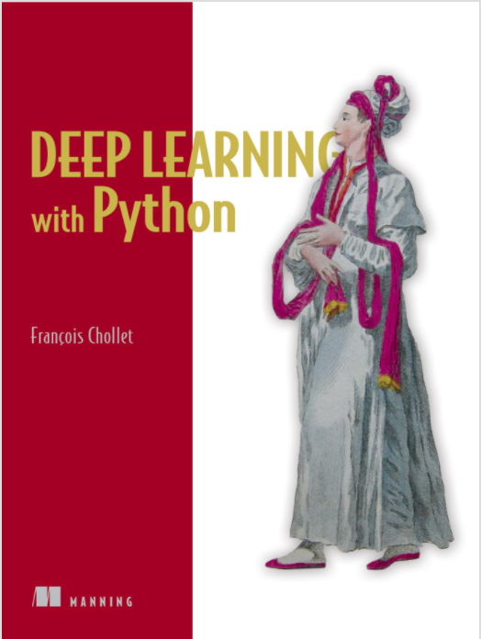
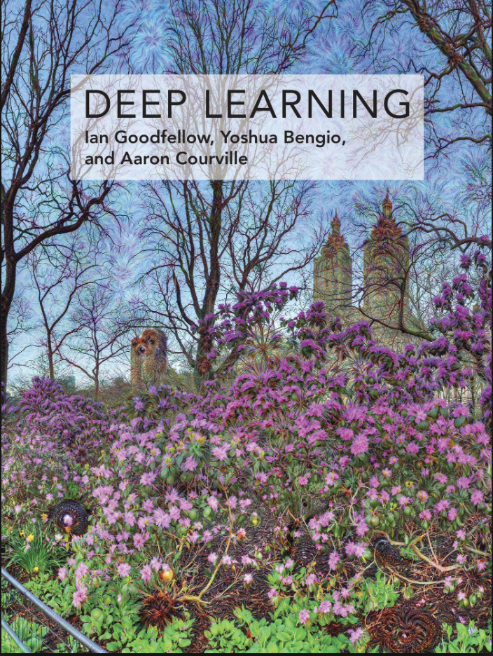
Further resources
This course is largely “inspired by”: “Deep Learning with Python” by François Chollet
Recommended textbook: “Deep learning” by Goodfellow, Bengio, Courville
Lots of further material available online, e.g.: http://cs231n.stanford.edu/ http://course.fast.ai/ https://developers.google.com/machine-learning/crash-course/ www.nvidia.com/dlilabs http://introtodeeplearning.com/ https://github.com/oxford-cs-deepnlp-2017/lectures, https://jalammar.github.io/
Academic courses

Slide 4
What is artificial intelligence?
Artificial intelligence is the ability of a computer to perform tasks commonly associated with intelligent beings.

Slide 5
What is machine learning?
Machine learning is the study of algorithms that learn from examples and experience instead of relying on hard-coded rules and make predictions on new data.

Slide 6
What is deep learning?
Deep learning is a subfield of machine learning focusing on learning data representations as successive layers of increasingly meaningful representations.

Slide 7

Image from https://blogs.nvidia.com/blog/2016/07/29/whats-difference-artificial-intelligence-machine-learning-deep-learning-ai/

Slide 8

“Traditional” machine learning:
handcrafted features
learned classifier
cat
Deep, “end-to-end” learning:
learned low-level features
learned mid-level features
learned high-level features
learned classifier
cat

Slide 9
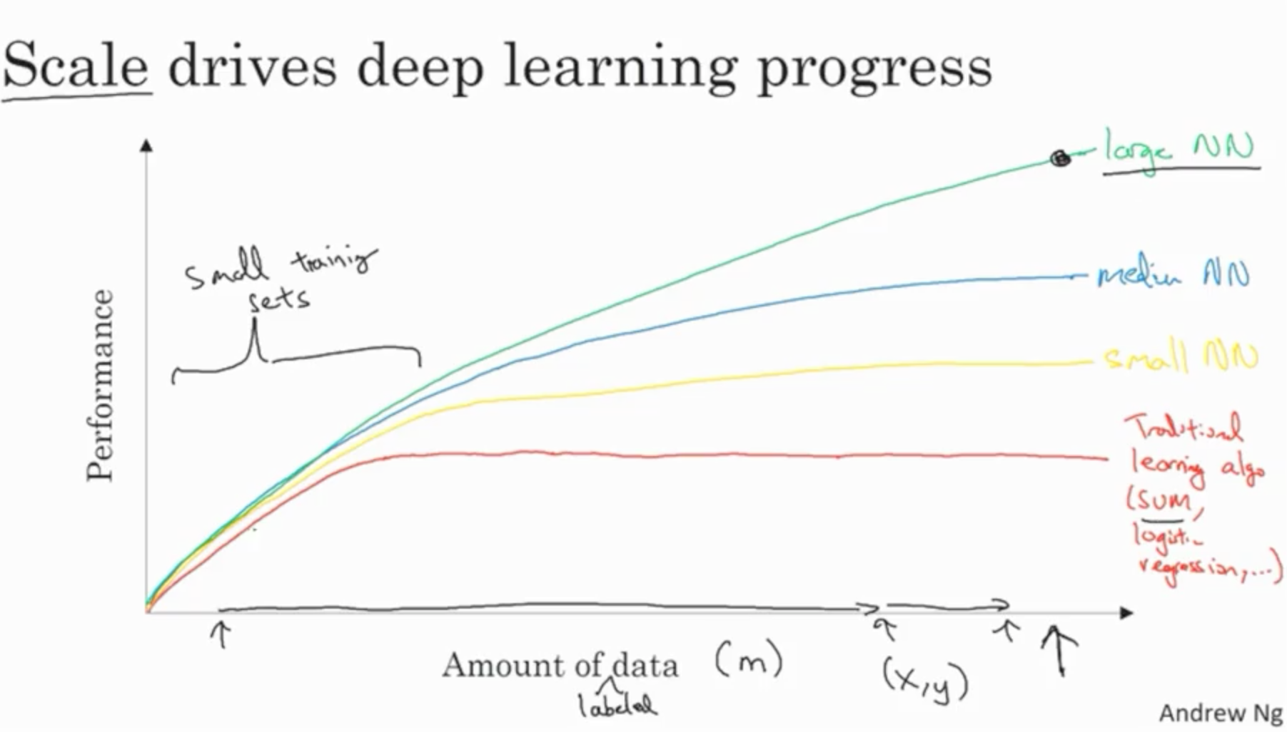

Slide 10
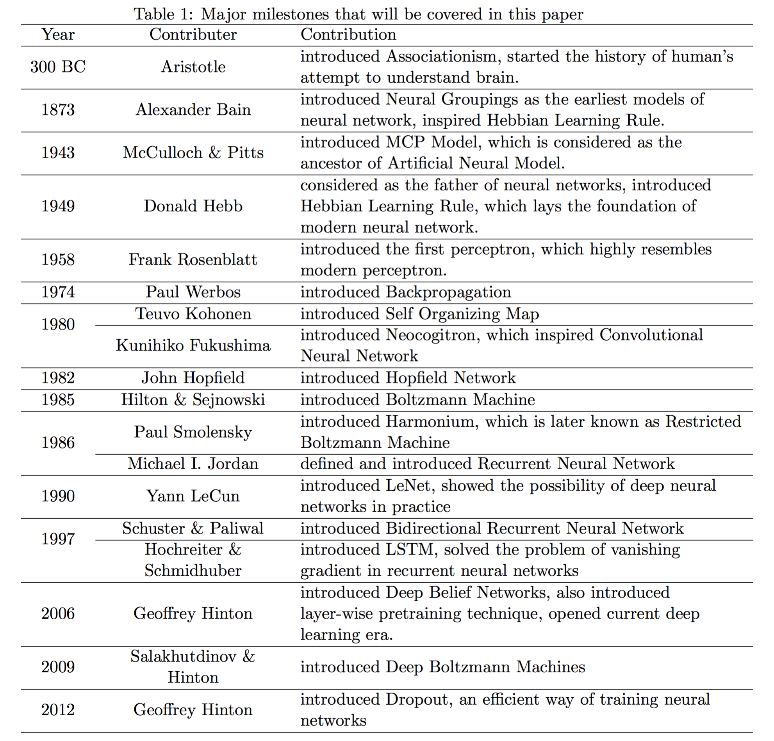
From: Wang & Raj: On the Origin of Deep Learning (2017)

Slide 11
Demotivational slide
“All of these AI systems we see, none of them is ‘real’ AI” – Josh Tennenbaum
“Neural networks are … neither neural nor even networks.” – François Chollet, author of Keras

Slide 12
Main types of machine learning

Slide 13
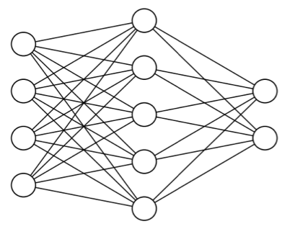
Main types of machine learning
Supervised learning
Unsupervised learning
Self-supervised learning
Reinforcement learning
cat
dog

Slide 14
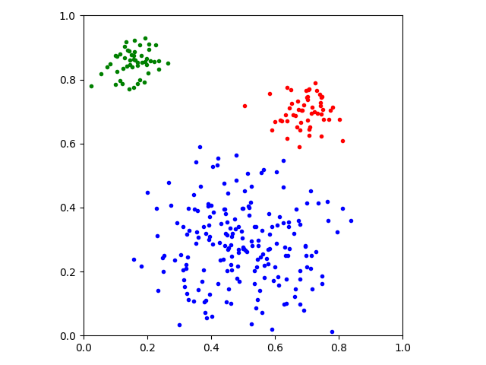
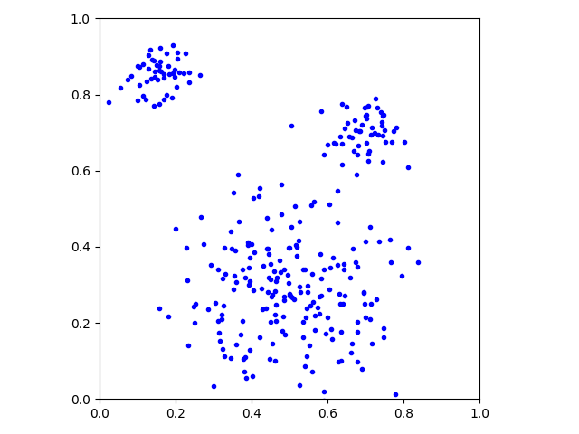
Main types of machine learning
Supervised learning
Unsupervised learning
Self-supervised learning
Reinforcement learning

Slide 15
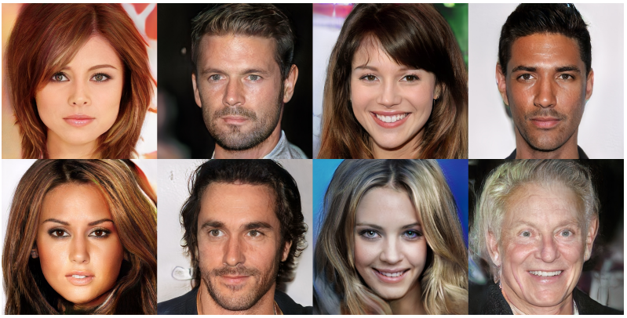
Main types of machine learning
Supervised learning
Unsupervised learning
Self-supervised learning
Reinforcement learning
Image from https://arxiv.org/abs/1710.10196

Slide 16
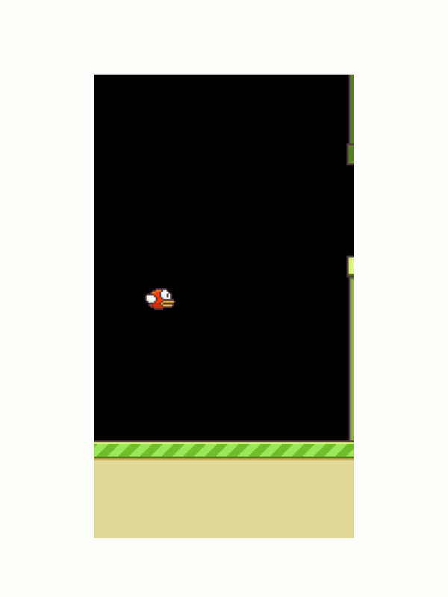
Main types of machine learning
Supervised learning
Unsupervised learning
Self-supervised learning
Reinforcement learning
Animation from https://yanpanlau.github.io/2016/07/10/FlappyBird-Keras.html

Slide 17
Fundamentals of machine learning

Slide 18
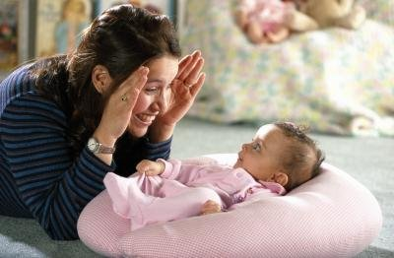
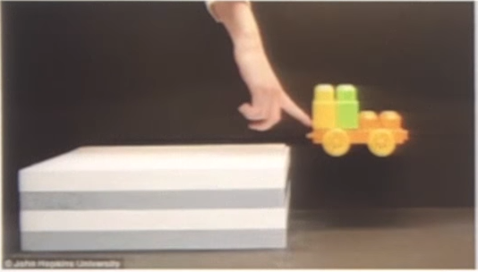
Data
Humans learn by observation and unsupervised learning
model of the world / common sense reasoning
Machine learning needs lots of (labeled) data to compensate

Slide 19
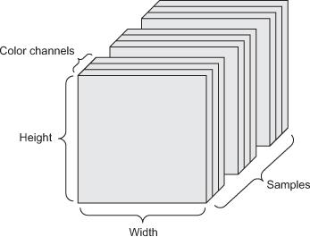

Data
Tensors: generalization of matrices to n dimensions (or rank, order, degree)
1D tensor: vector
2D tensor: matrix
3D, 4D, 5D tensors
numpy.ndarray(shape, dtype)
Training – validation – test split (+ adversarial test)
Minibatches
small sets of input data used at a time
usually processed independently
Image from: https://arxiv.org/abs/1707.08945

Slide 20
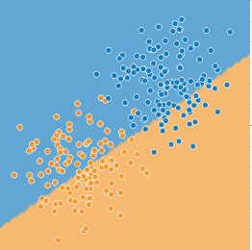
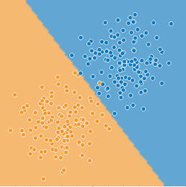
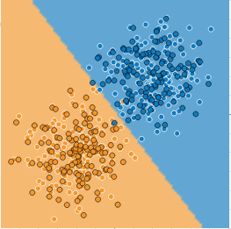
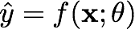
Model – learning/training – inference
http://playground.tensorflow.org/
parameters 𝜃 and hyperparameters

Slide 21
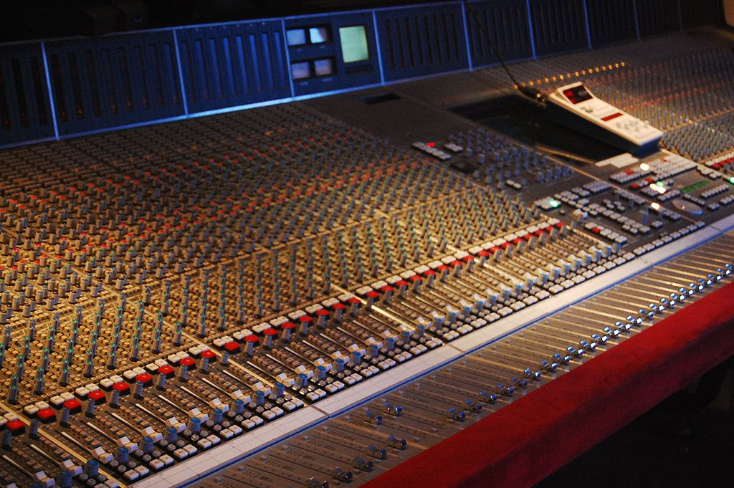
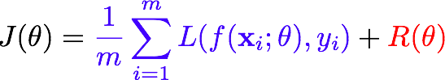
Optimization
Mathematical optimization: “the selection of a best element (with regard to some criterion) from some set of available alternatives” (Wikipedia)
Main types: finite-step, iterative, heuristic
Learning as an optimization problem
cost function:
By Rebecca Wilson (originally posted to Flickr as Vicariously) [CC BY 2.0], via Wikimedia Commons
loss
regularization

Slide 22
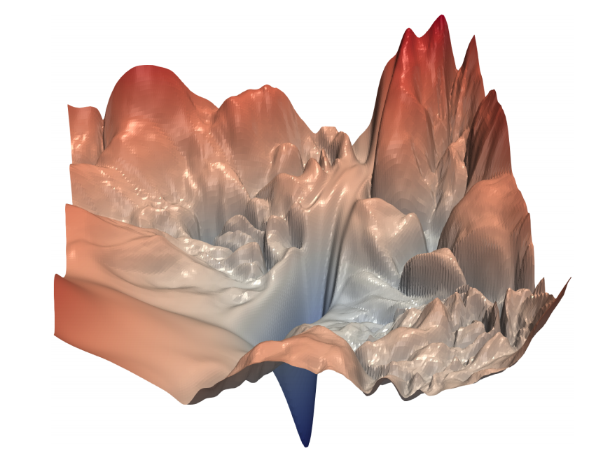
Optimization
Image from: Li et al. “Visualizing the Loss Landscape of Neural Nets”, arXiv:1712.09913

Slide 23
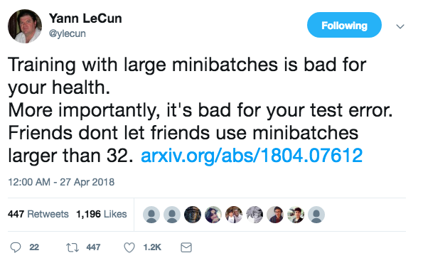
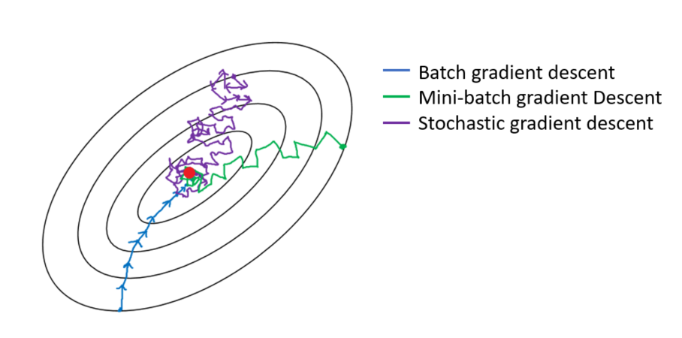
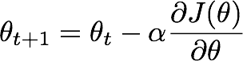
Gradient descent
Derivative and minima/maxima of functions
Gradient: the derivative of a multivariable function
Gradient descent:
(Mini-batch) stochastic gradient descent (and its variants)
Image from: https://towardsdatascience.com/gradient-descent-algorithm-and-its-variants-10f652806a3

Slide 24
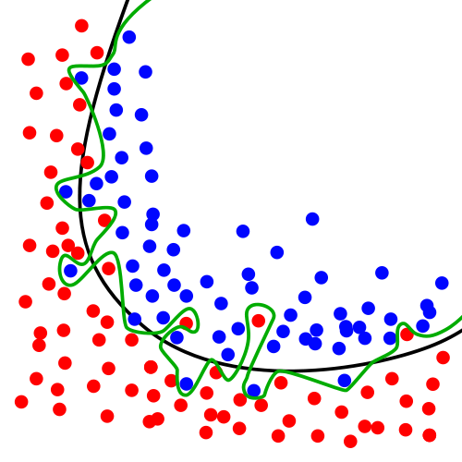
Over- and underfitting, generalization, regularization
Models with lots of parameters can easily overfit to training data
Generalization: the quality of ML model is measured on new, unseen samples
Regularization: any method* to prevent overfitting
simplicity, sparsity, dropout, early stopping
*) other than adding more data
By Chabacano [GFDL or CC BY-SA 4.0], from Wikimedia Commons

Slide 25
Deep learning

Slide 26
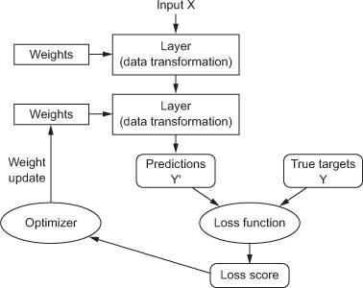
Anatomy of a deep neural network
Layers
Input data and targets
Loss function
Optimizer

Slide 27
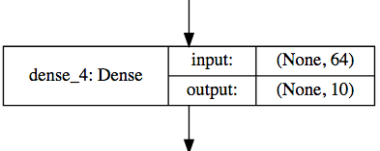
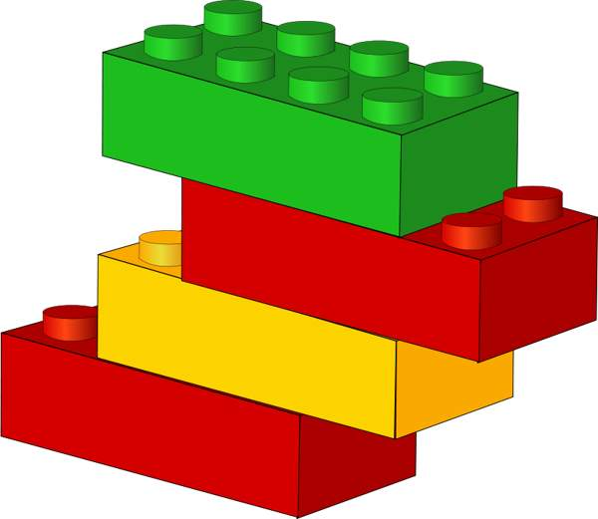
Layers
Data processing modules
Many different kinds exist
densely connected
convolutional
recurrent
pooling, flattening, merging, normalization, etc.
Input: one or more tensors output: one or more tensors
Usually have a state, encoded as weights
learned, initially random
When combined, form a network or a model

Slide 28
Input data and targets
The network maps the input data X to predictions Y′
During training, the predictions Y′ are compared to true targets Y using the loss function
cat
dog

Slide 29
Loss function
The quantity to be minimized (optimized) during training
the only thing the network cares about
there might also be other metrics you care about
Common tasks have “standard” loss functions:
mean squared error for regression
binary cross-entropy for two-class classification
categorical cross-entropy for multi-class classification
etc.
https://lossfunctions.tumblr.com/

Slide 30
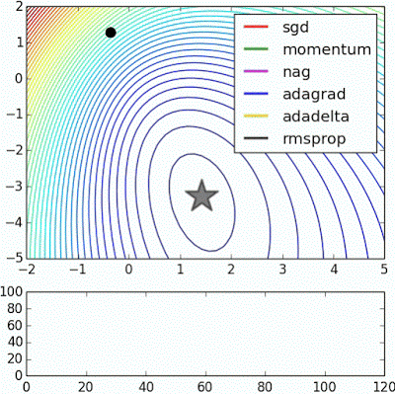
Optimizer
How to update the weights based on the loss function
Learning rate (+scheduling)
Stochastic gradient descent, momentum, and their variants
RMSProp is usually a good first choice
more info: http://ruder.io/optimizing-gradient-descent/
Animation from: https://imgur.com/s25RsOr
Notes:
RMSProp mentioned in Hinton’s lecture notes

Slide 31
Anatomy of a deep neural network

Slide 32
Deep learning frameworks

Slide 33












Slide 34
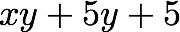
Deep learning frameworks
Actually tools for defining static or dynamic general-purpose computational graphs
Automatic differentiation
Seamless CPU / GPU usage
multi-GPU, distributed
Python/numpy or R interfaces
instead of C, C++, CUDA or HIP
Open source
+
+
✕
✕
x
y
5

Slide 35
Deep learning frameworks
Lasagne
Keras
TF Estimator
torch.nn
Gluon
Theano
TensorFlow
CNTK
PyTorch
MXNet
Caffe
CUDA, cuDNN HIP, MIOpen
MKL, MKL-DNN
Keras is a high-level neural networks API
we will use TensorFlow as the compute backend
included in TensorFlow 2 as tf.keras
https://keras.io/ , https://www.tensorflow.org/guide/keras
PyTorch is:
a GPU-based tensor library
an efficient library for dynamic neural networks
https://pytorch.org/
GPUs
CPUs

